Slide 1
FURTHER UPDATES ON THE INSPACe INTERNSHIP
PRESENTED BY:
MUBASHIR SALIM
AMAN RAINA
ANSEL PAUL

Slide 2
Introduction
The IN-SPACe web application is being rebuilt from scratch to enhance user experience, streamline workflows, and improve communication.
The project involves frontend development, backend development, authentication, database management, and real-time communication.
Different user roles include Normal Users, Verifiers, Assigners, and Admins.
The goal is to create a secure, efficient, and user-friendly system that simplifies form submission, verification, and approvals.

Slide 3
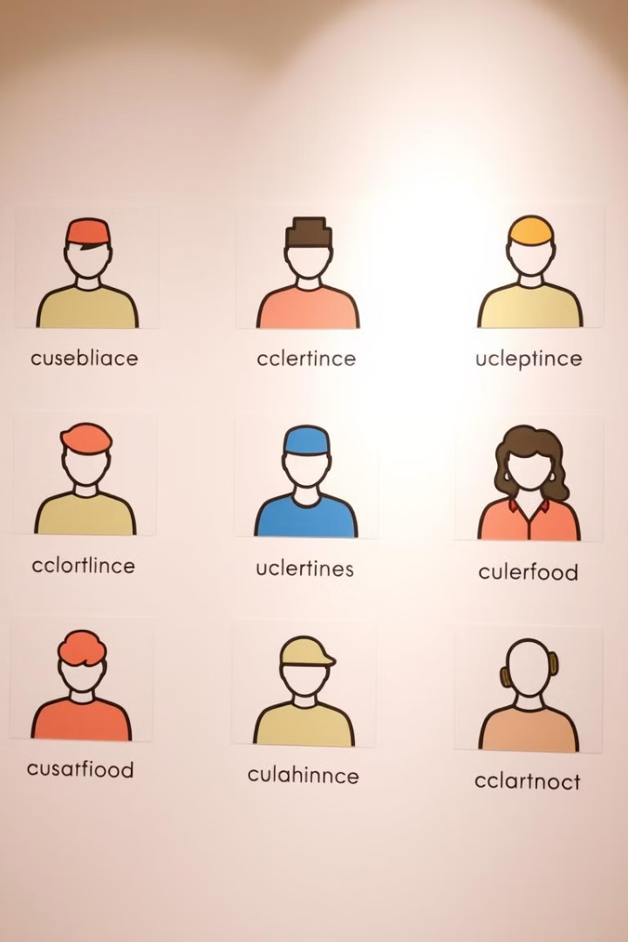
User Roles
Normal Users
Submit applications and track their status.
Verifiers
Review applications and request corrections.
Assigners
Assign applications to specific verifiers.
.
Admins
Manage users, track applications, and make final decisions.
.

Slide 4
Key Features
User Registration & Authentication
Form Submission System
Verifier & Assigner Workflow
Secure login and signup with role-based access control.
Multi-step forms for user applications with validation and progress tracking.
Streamlined process for reviewing and assigning applications.
Real-time Chat System
Admin Panel for Management
Database & Backend Optimization
Communication between verifiers and assigners via WebSockets.
User control, application tracking, logs, and performance metrics.
SQLAlchemy for improved performance and efficiency.
7
UI/UX Enhancement using Tailwind CSS
Responsive and modern design for a user-friendly experience.

Slide 5




User Authentication System
Login & Signup
Session Management
Password Hashing
Users authenticate via Flask-Login with role-based access control.
Secure handling of sessions to prevent unauthorized access.
Secure password storage using Flask-Bcrypt.
Role-Based Access
Different user roles have specific permissions.

Slide 6
Form Submission System
Multi-Step Forms
Users submit applications with personal information, management details, and document uploads.
Form Validation
Flask-WTF ensures security and data integrity.
Real-time Status Tracking
Progress indicators show the current stage of the application.
Email Notifications
Automatic notifications upon submission and updates.

Slide 7





Verifier & Assigner Workflow
User Submission
Users submit applications via the online form system.
Verifier Review
Verifiers check the submitted applications and request corrections if needed.
Assignment by Assigner
Assigners assign a specific verifier to the application.
Approval/Rejection
Verifiers either approve or reject applications.
Final Review by Admin
Approved applications go to the admin for the final decision.

Slide 8
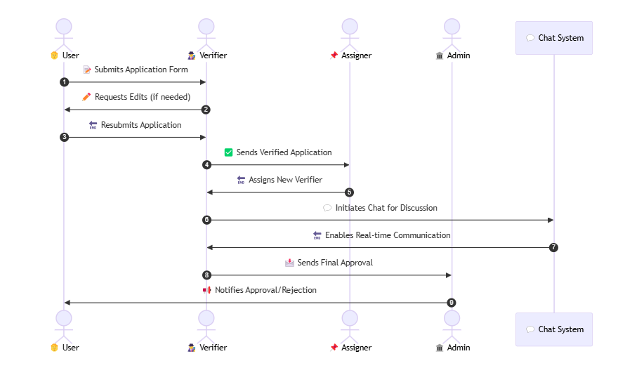
WORKFLOW DIAGRAM

Slide 9
Admin Panel Features
Dashboard for Tracking Applications
Role-Based Access Control
Manage user permissions and access levels.
View pending, approved, and rejected applications.
User Management
Add, remove, and modify users.
Data Export & Logs for Auditing
Performance Metrics & Analytics
Export data and view logs for auditing purposes.
Track system performance and user activity.

Slide 10
Current Progress Update
User Authentication System
Completed
Multi-Step Form Submission
Completed
Verifier & Assigner Workflow
Completed
Real-time Chat Implementation
Completed
Admin Panel Development
Completed
Notification System
In Progress

Slide 11
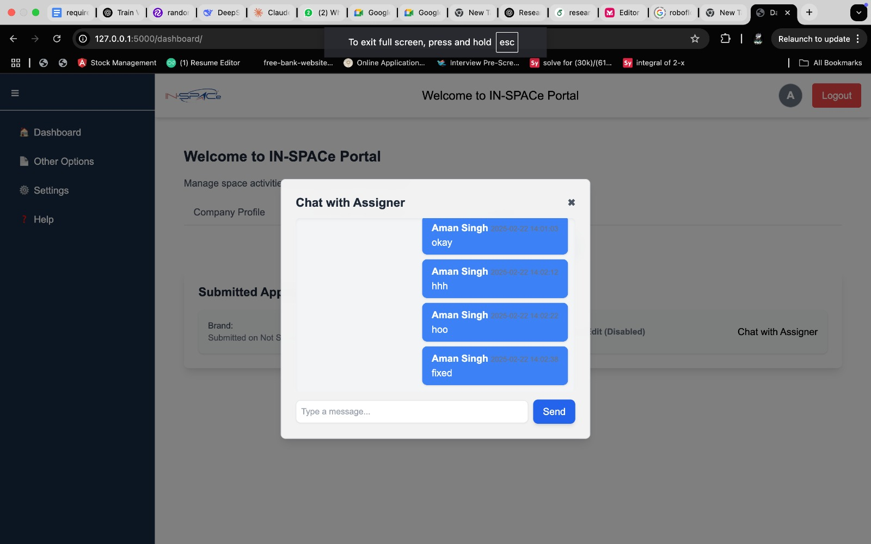

Slide 12
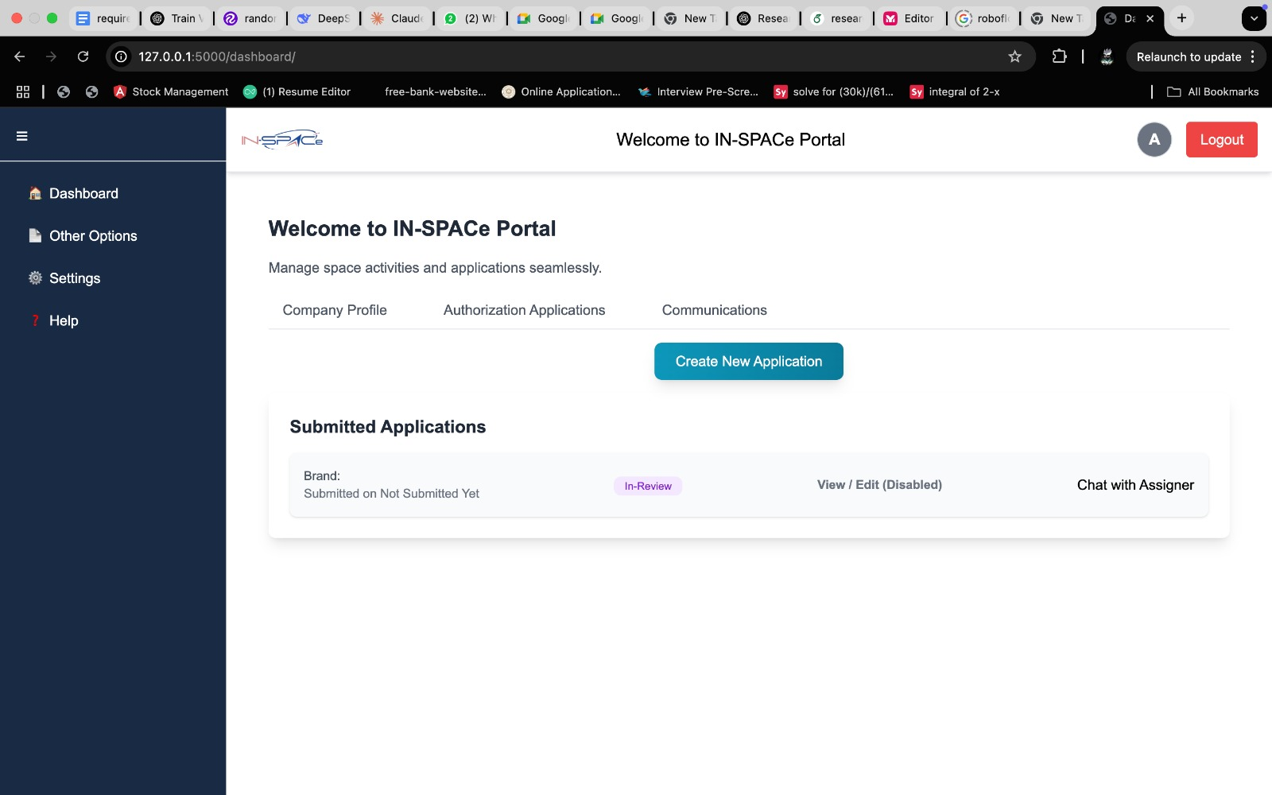

Slide 13
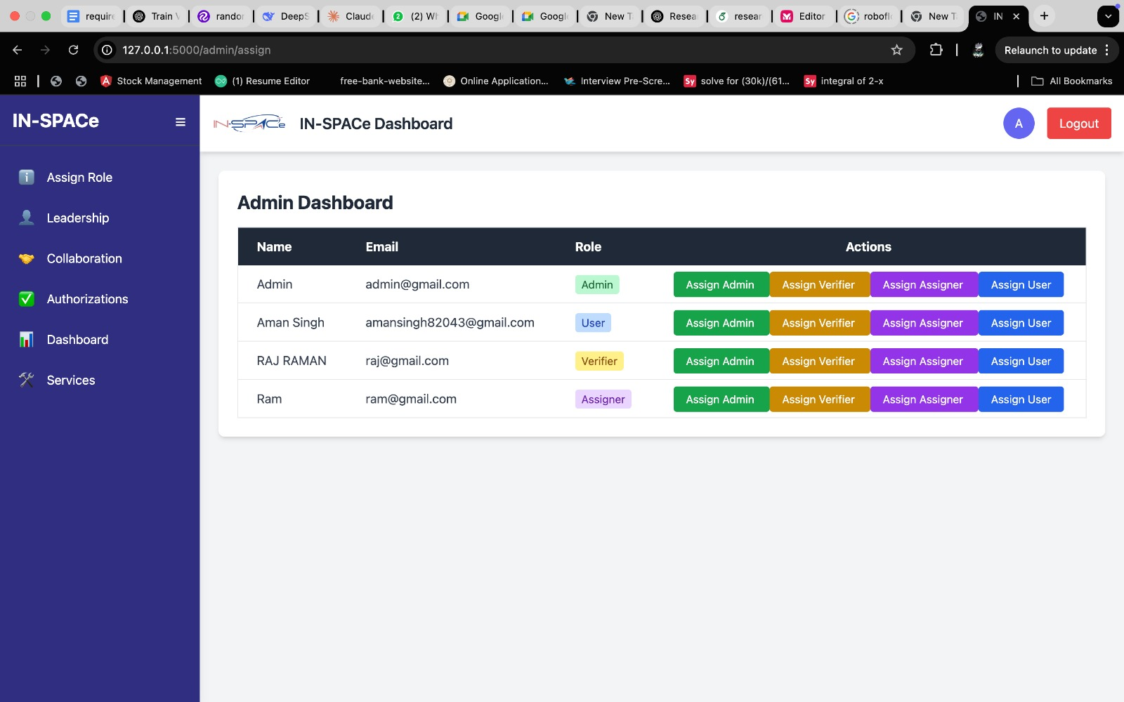

Slide 14
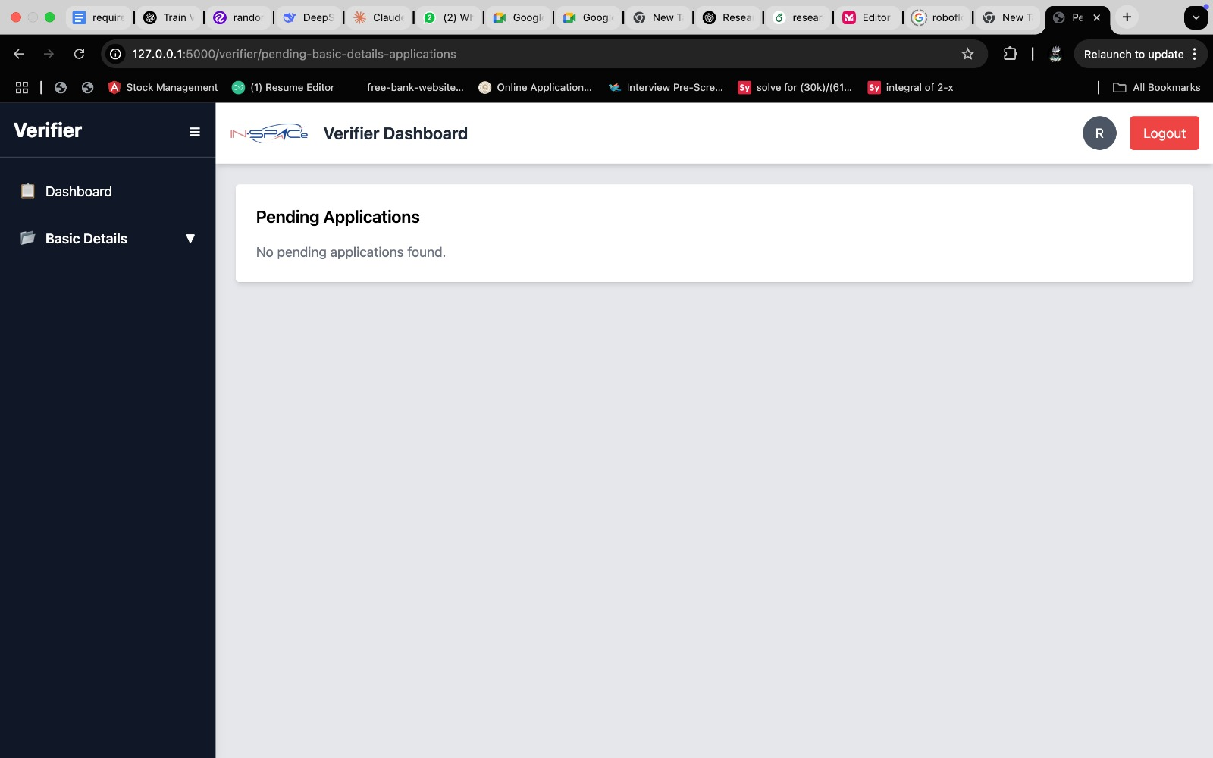

Slide 15
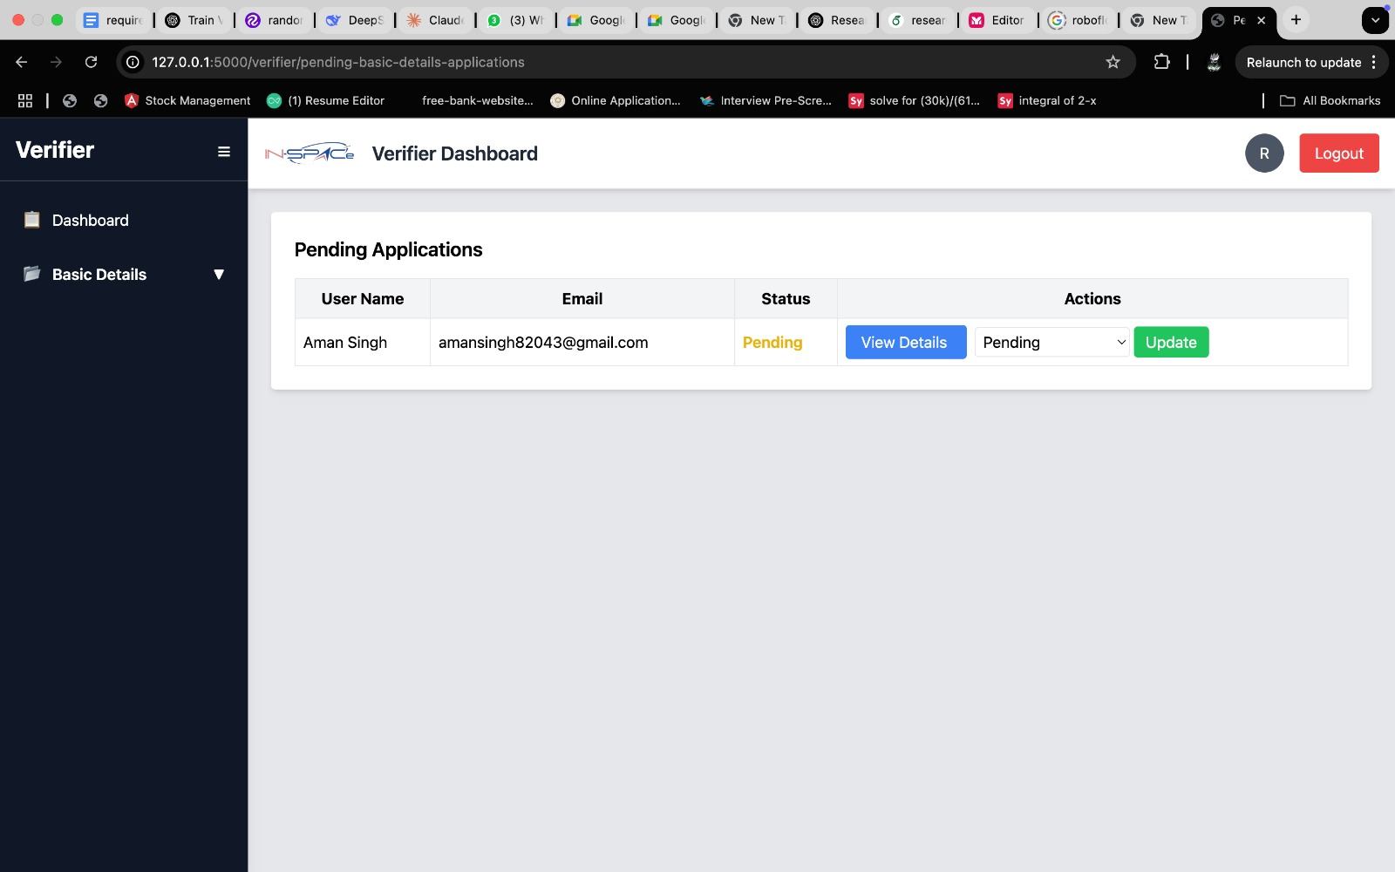

Slide 16
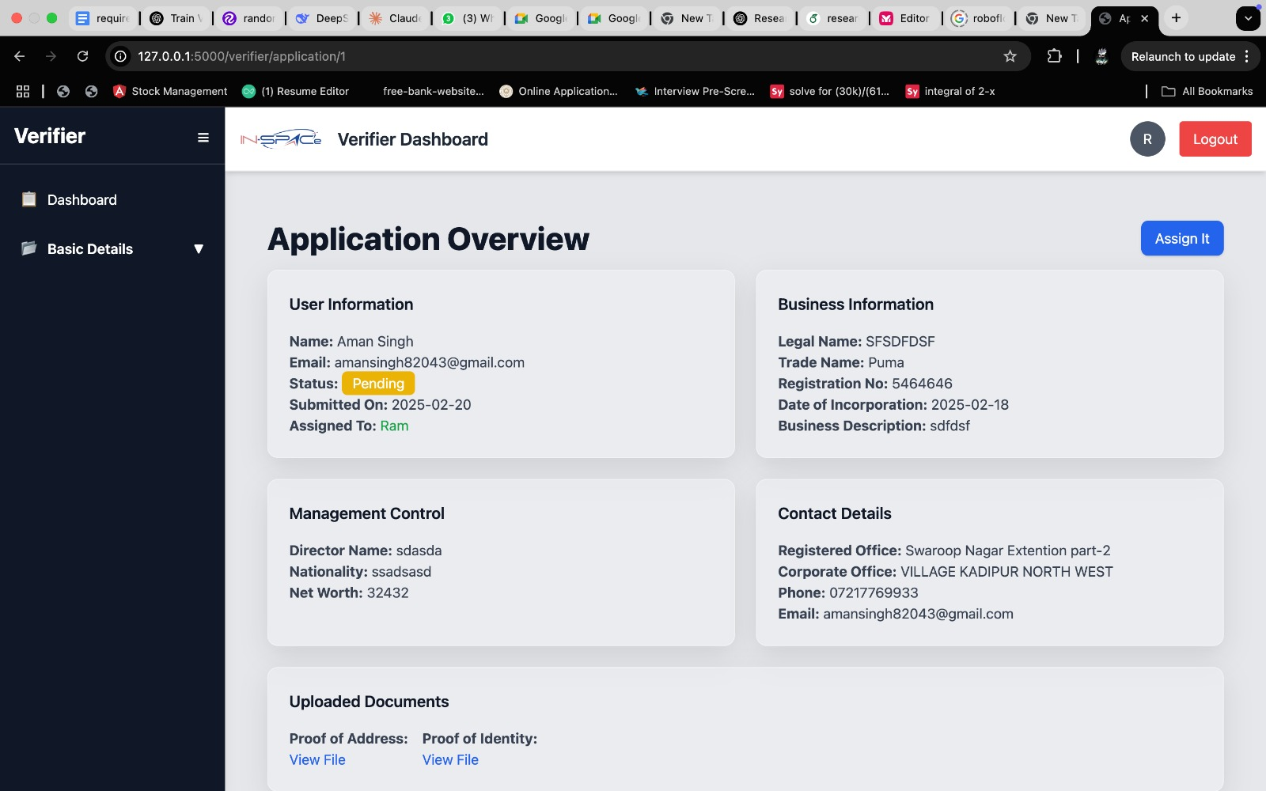

Slide 17
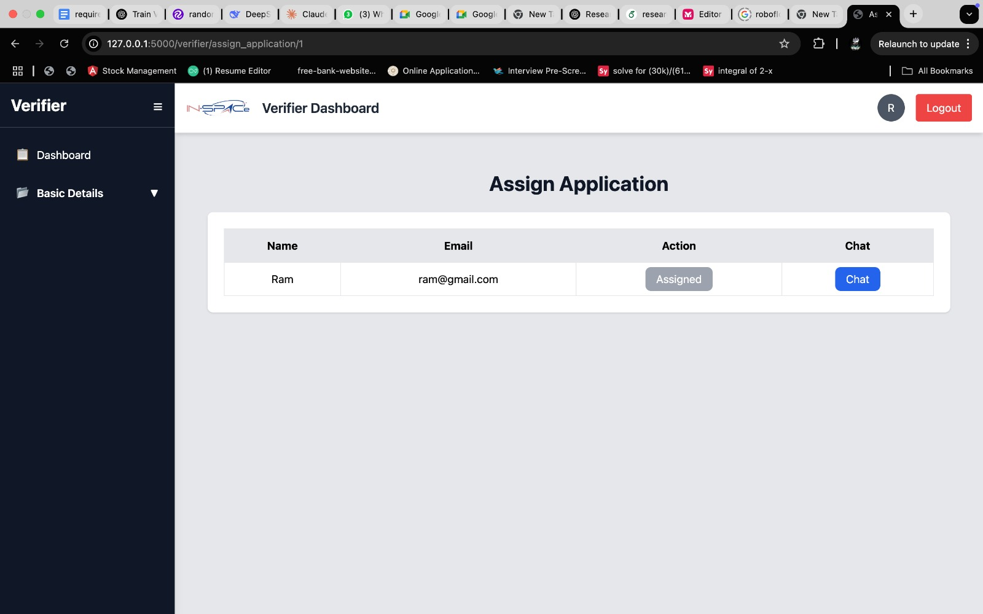

Slide 18
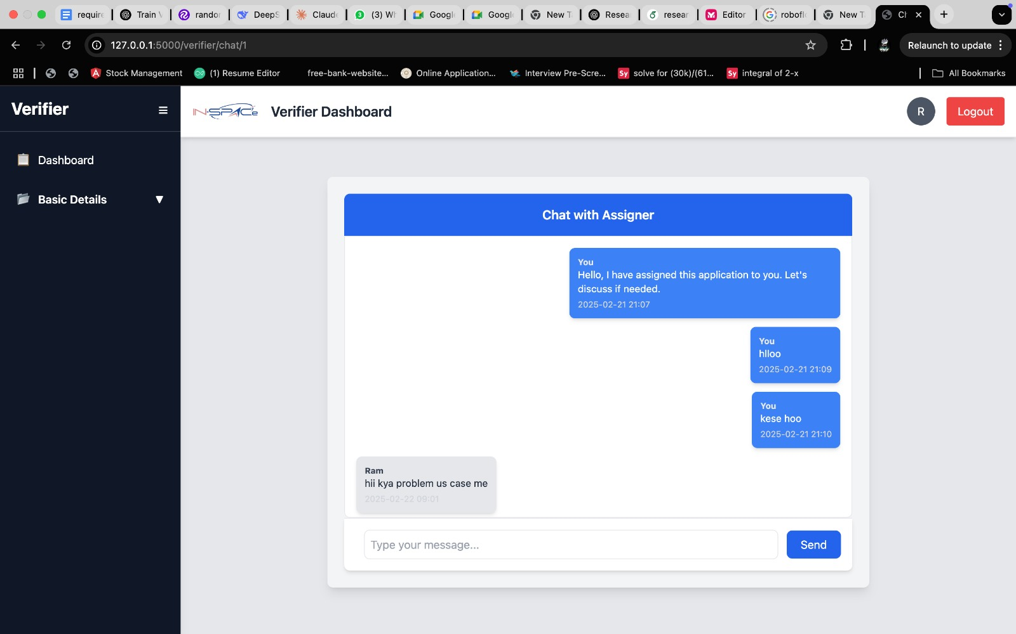

Slide 19
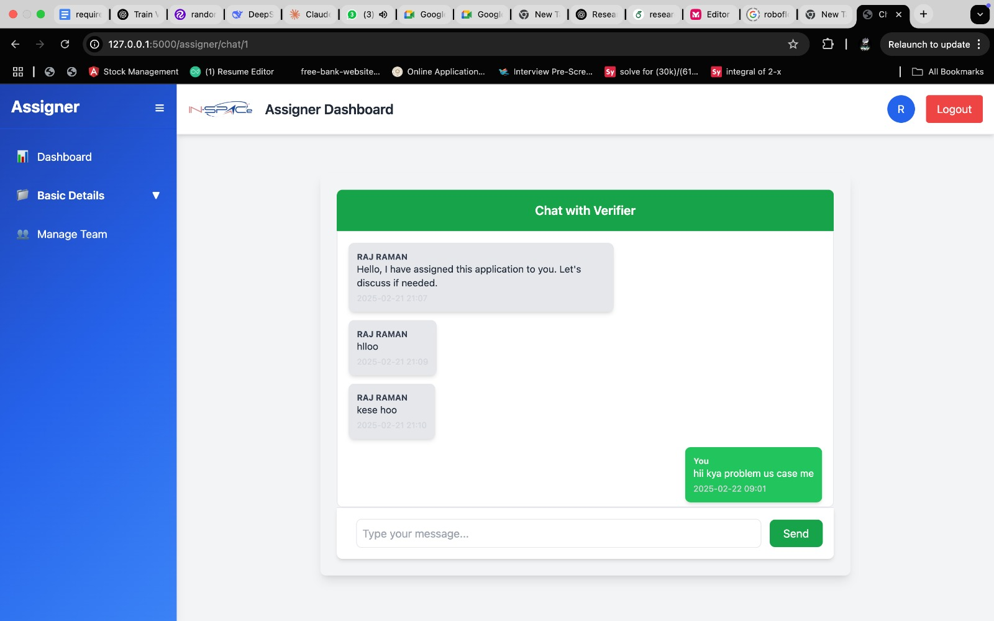

Slide 20
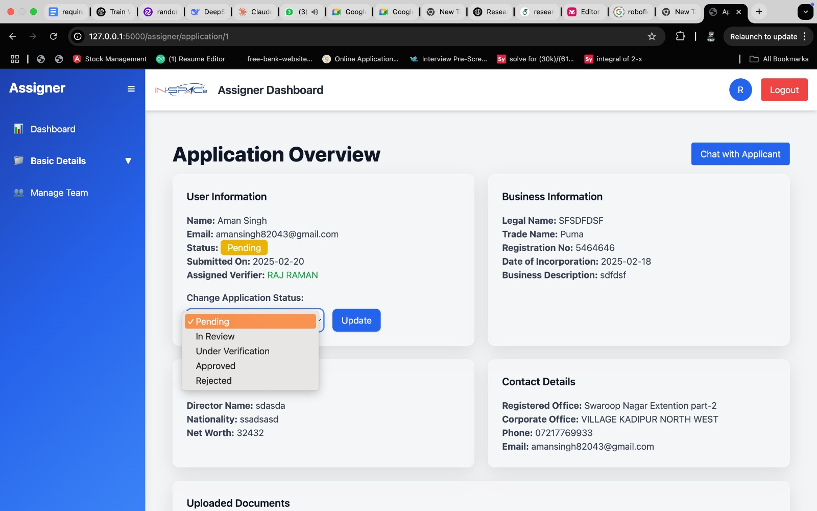

Slide 21
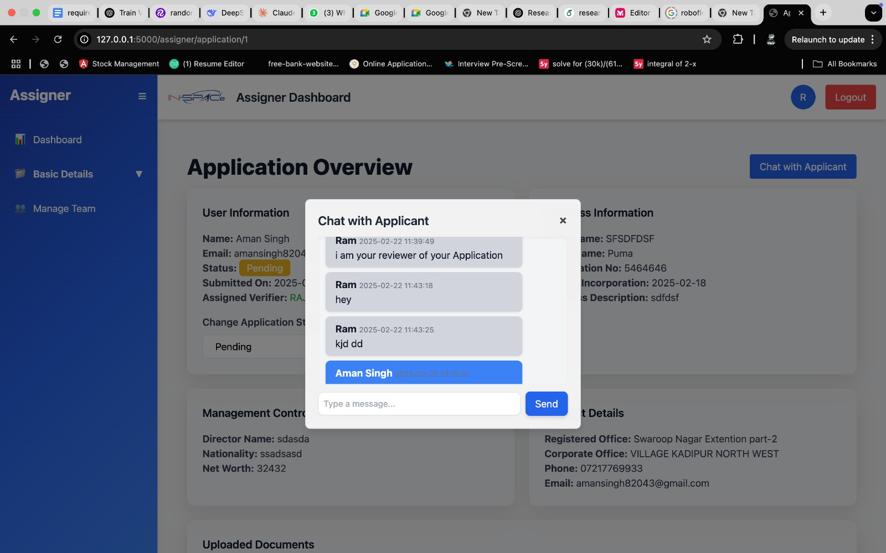

Slide 22
Future Tasks & Improvements
Implement a notification system for real-time status updates.
Optimize database queries for better performance.
Enhance the chat system with file sharing & attachments.
Develop a dashboard for admins to track all processes in real-time.
Improve analytics & reporting for system usage insights.

Slide 23
Conclusion
The system is now more modular, secure, and user-friendly.
Enhanced efficiency in form submissions, verification, and communication.
Provides a seamless workflow for different user roles.
Real-time interaction between verifiers and assigners is now possible.

